Slide 1

CSE-416
Computer Graphics Sessional
Prepared By:
Kazi Rafid Raiyan 201814022
M M Rushadul Mannan 201814056

Slide 2
Project Title:
Interstellar Galaxy

Slide 3
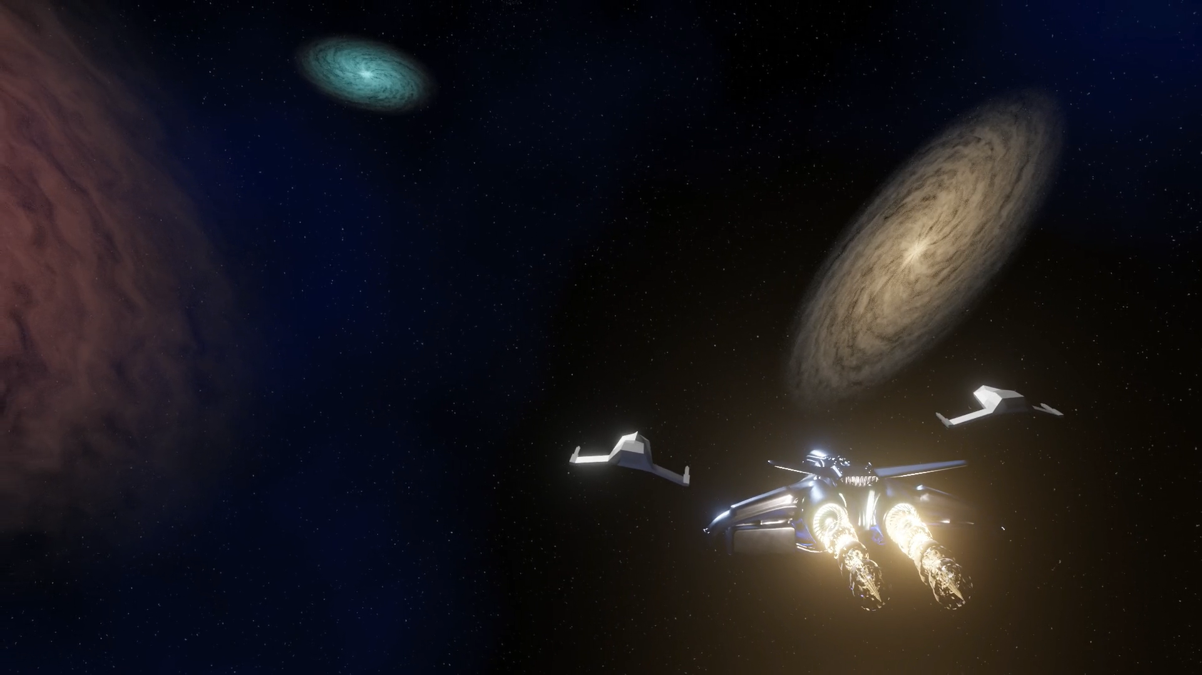
Overview of the project idea:
There will be 3 galaxy and some meteoroids floating on zero space. There will be a power source and some intergalactic space vehicles will be flying towards the star. An astronaut will be floating in front of the power source and will be waving his hand.

Slide 4
Objective of the project:
Apply knowledge of Blender software.
Model 3D objects.
Add textures and noise to 3D objects.
Add animation and rigging.
Use camera to capture scenes.
Render a Intergalactic spaceship and interstellar galaxy.

Slide 5
Feature list:
4 Custom 3D models
Model rigging
Animation added to rigged model
Audio file included
Coloring + texture
Video length 1:10 minutes

Slide 6
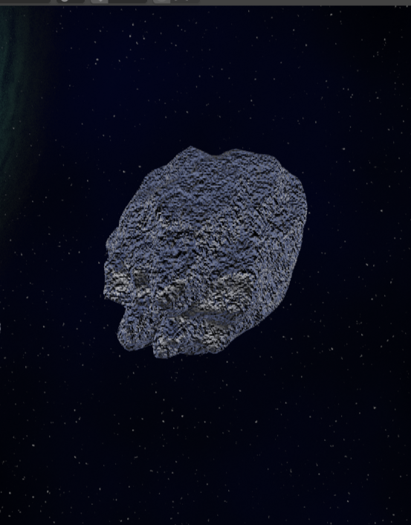
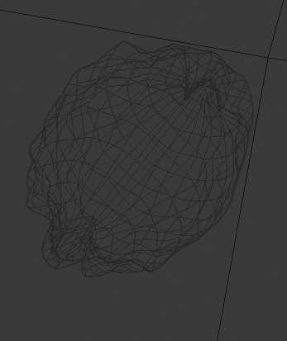
List of own created models:
Asteroids

Slide 7
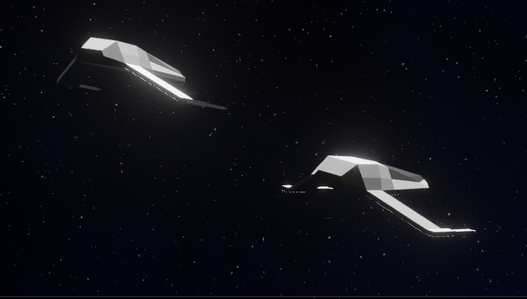
List of own created models:
2. Spaceship

Slide 8
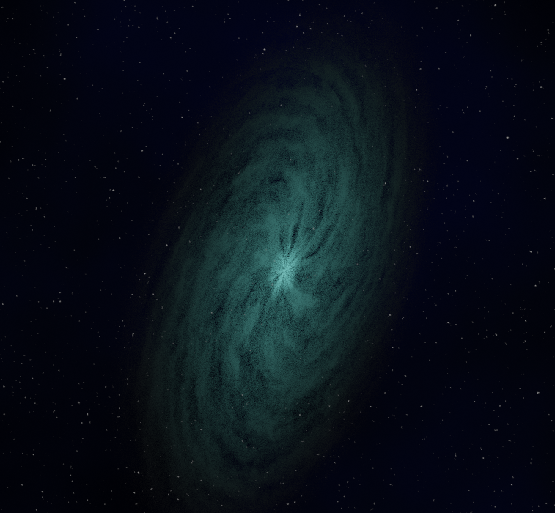
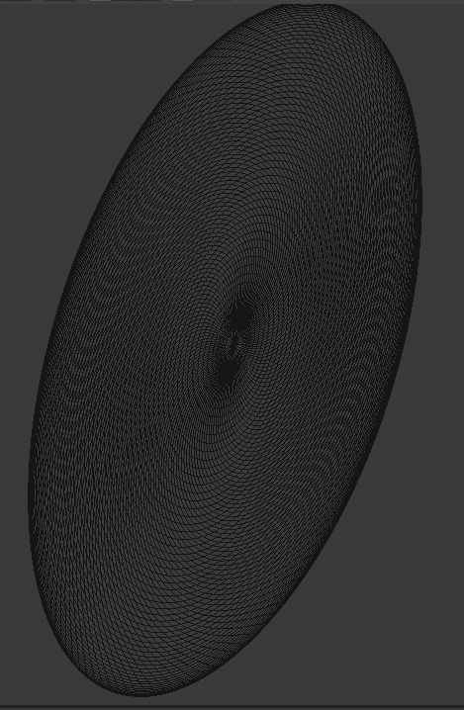
List of own created models:
3. Galaxy

Slide 9
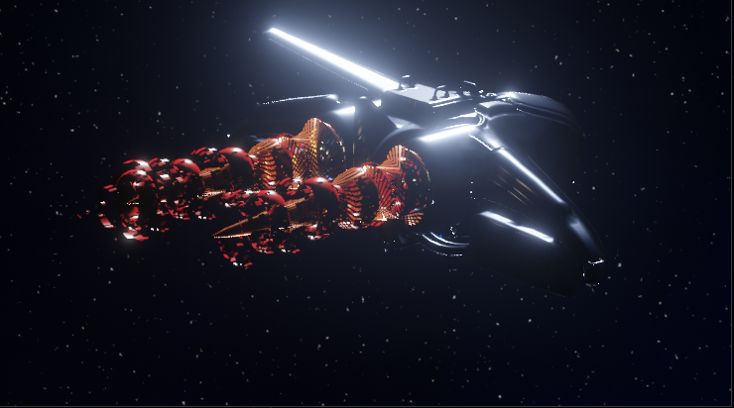
List of Imported models:
Intergalactic Spaceship

Slide 10
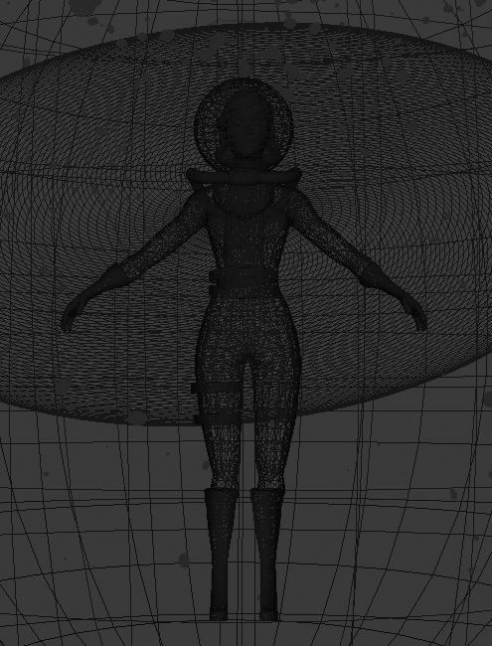
List of Imported models:
Astronaut

Slide 11
Animation:
Play video

Slide 12
THANK YOU

